Slide 1
AMAZON PRODUCT REVIEW ANALYSIS
LAKSHMIPATHI
RANJANA SHUKLA
SHWETA SINGH

Slide 2
OBJECTIVE
Knowing the product acceptance of the customers.
Identifying the areas where the customer shopping experience could be improved.
Helping in reducing the customer churn.
Helping in improving the product recommendations to the customers.

Slide 3
DATA DESCRIPTION
DATA SOURCE : Product Reviews data and Metadata from Amazon spanning May 1996 - July 2014.
CATEGORIES USED FOR THIS ANALYSIS : Digital Music and Musical Instruments
DIGITAL MUSIC : 8,36,006 Records
MUSICAL INSTRUMENTS : 5,00,176 Records
SAMPLE TAKEN: 3,00,000 Records

Slide 4
TREATMENT TO THE DATASET
For the analysis, the review text is taken as the input.
Null values are dropped.
The review text is cleaned.

Slide 5
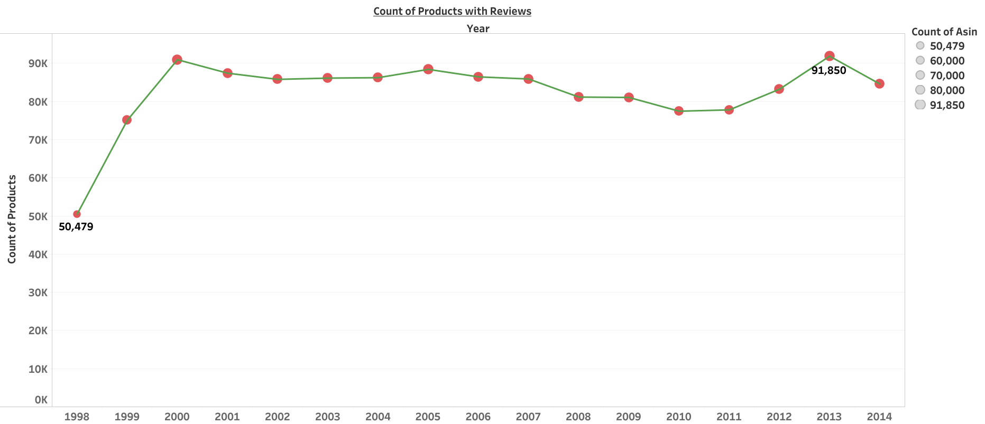
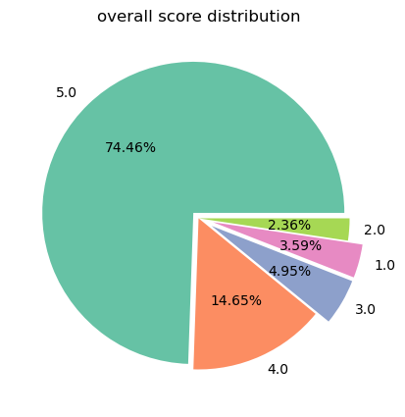
Digital Music category
Year wise Count of Reviewed Products
l
Count of reviewed products
Most no. of the reviewed products have a overall score of 5.0
More number of reviewed products are coming in when compared to previous years.

Slide 6
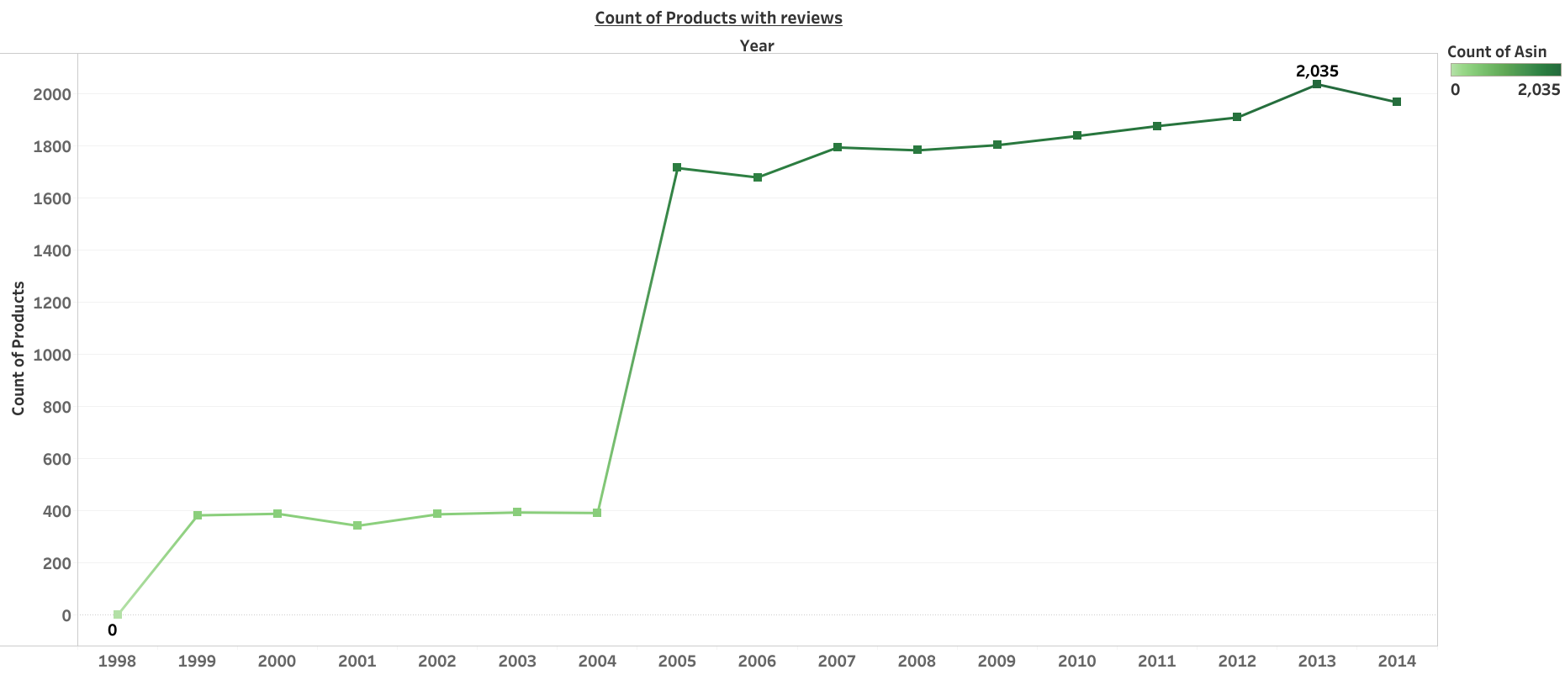
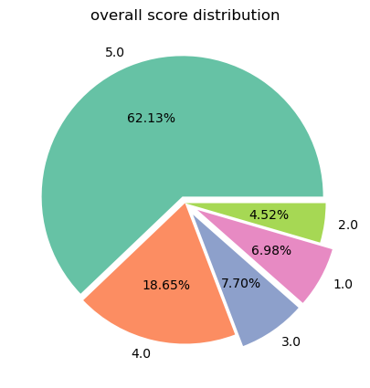
Musical Instruments category
Year wise Count of Reviewed Products
l
Count of reviewed products
Most no. of the reviewed products have a overall score of 5.0
More number of reviewed products are coming in when compared to previous years.

Slide 7
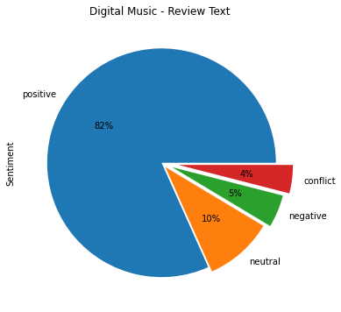
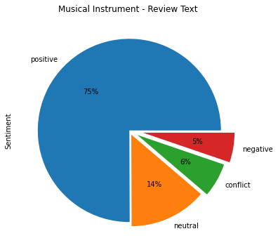
PREDICTING SENTIMENTS
The sentiments of the review text is predicted using Sentiment Intensity Analyzer model.

Slide 8
TEXT CLASSIFICATION DIGITAL MUSIC CATEGORY
Text classification is done for review text using Multinomial Naïve Bayes, Ada Boost, Decision Tree Classifier & Random Forest Classifier.
MODEL | ACCURACY
Multinomial Naïve Bayes | 81 %
Ada Boost | 82 %
Decision Tree Classifier | 77 %
Random Forest Classifier | 81 %
REVIEW TEXT | ACTUAL | ADA BOOST PREDICTED
certainly of very good sound quality a couple of new songs that are not on paint the sky with stars an enjoyable and relaxing listen | Positive | Positive
i remember listening to this cd back in high school it is too bad the audio quality in comparison to today s is soooo bad | Negative | Negative

Slide 9
TEXT CLASSIFICATION MUSICAL INSTRUMENTS CATEGORY
Text classification is done for review text using Multinomial Naïve Bayes, Ada Boost, Decision Tree Classifier & Random Forest Classifier.
MODEL | ACCURACY
Multinomial Naïve Bayes | 75 %
Ada Boost | 77 %
Decision Tree Classifier | 71 %
Random Forest Classifier | 76 %
REVIEW TEXT | ACTUAL | ADA BOOST PREDICTED
some really cool riffs that can be incorporated into your playing instructor could have spent a little more time explaining and breaking them down but i guess they had to stay within a certain allotted recording time | Positive | Positive
universal should be ashamed of themselves it s a pure money-grubbing release this set is neither special nor collectible | Negative | Negative

Slide 10
EVALUATION BASED ON F1 SCORES OF BEST PERFORMING MODEL
 | DIGITAL MUSIC CATEGORY | MUSICAL INSTRUMENT CATEGORY
CLASS | F1 SCORE (ADA BOOST) | F1 SCORE (ADA BOOST)
POSITIVE | 92 % | 89 %
NEGATIVE | 28 % | 32 %
NEUTRAL | 15 % | 35 %
CONFLICT | 10 % | 3 %

Slide 11
CUSTOMER COMPLAINTS ABOUT PRODUCTS IN DIGITAL MUSIC CATEGORY
PRODUCT ID | PRODUCT NAME | COMPLAINT
B000000509 | Return of the Boom Bap | The sound quality is terrible & the music is so loud.
B0000024Z9 | Sloppy Seconds | The CD is full of scratches.
B000002PH1 | Heaven on Earth | The customer has to pay a fee for playing the song in cloud player.
Complaints are taken from the product reviews of the customer

Slide 12
CUSTOMER COMPLAINTS ABOUT PRODUCTS IN MUSICAL INSTRUMENTS CATEGORY
PRODUCT ID | PRODUCT NAME | COMPLAINT
B00006343B | Casio GSDX Deluxe Keyboard Stand | Parts and screws are missing.
B00006HOLL | Sony ECM-DS70P Electret Condenser Stereo Microphone | Not compatible and poor sound quality.
B0000BY7SF | TAO Video Karaoke Machine | The item came damaged in delivery.
Complaints are taken from the product reviews of the customer

Slide 13
EXTRACTING PRODUCT NAMES FROM CATEGORIES
DIGITAL MUSIC PRODUCTS
MUSICAL INSTRUMENT PRODUCTS
PRODUCT ID | PRODUCT NAME
B000002MKL | For no one
B000002L88 | i wanna be your man
B000002LPF | all together now
B0000072X3 | bad to me
B00000DQSE | her majesty
PRODUCT ID | PRODUCT NAME
0014072149 | violin
0739079883 | guitar
0977875652 | piano
0849734339 | bass
0739046500 | baritone
Entity Recognition and POS Tagging is used here to extract the following product names from the review text.

Slide 14
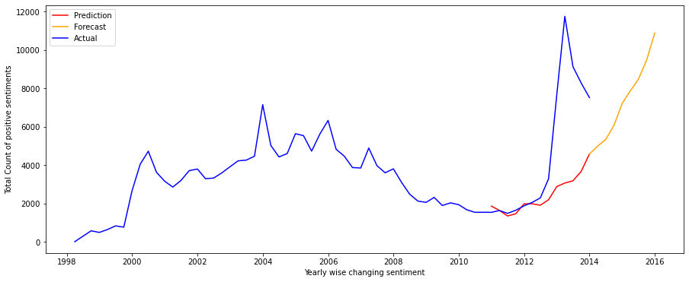
POSITIVE REVIEWS COUNT FORECAST FOR DIGITAL MUSIC CATEGORY
2016 JAN
10000
2014 JAN
5000

Slide 15
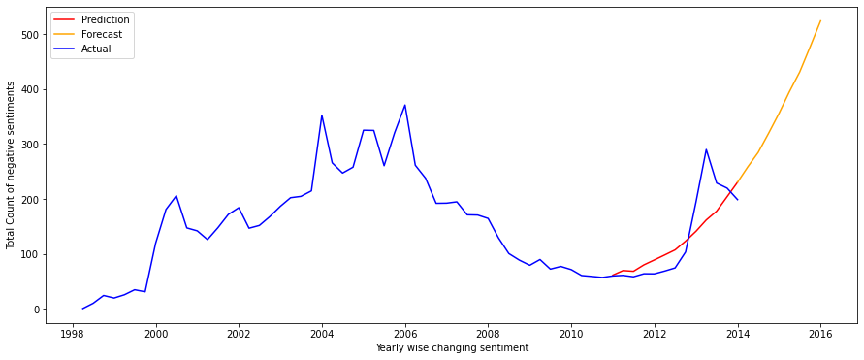
NEGATIVE REVIEWS COUNT FORECAST FOR DIGITAL MUSIC CATEGORY
2016 JAN
500
2014 JAN
250

Slide 16
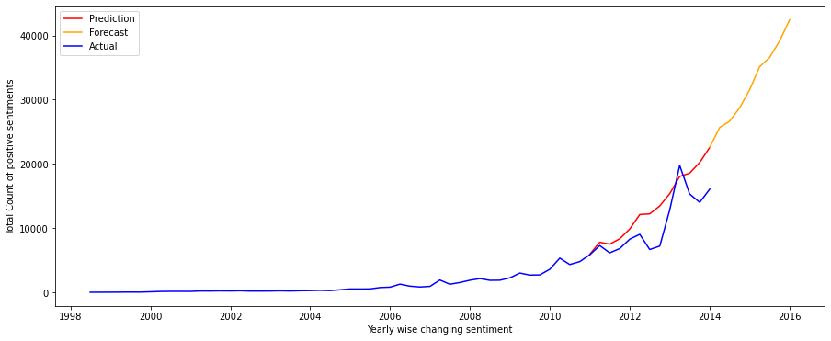
POSITIVE REVIEWS COUNT FORECAST FOR MUSICAL INSTRUMENTS CATEGORY
2016 JAN
40000
2014 JAN
20000

Slide 17
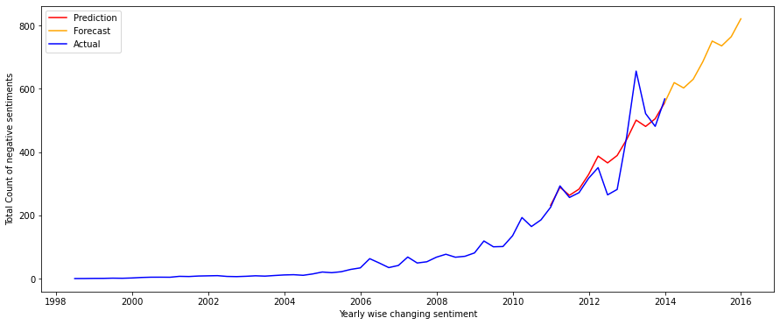
NEGATIVE REVIEWS COUNT FORECAST FOR MUSICAL INSTRUMENTS CATEGORY
2016 JAN
800
2014 JAN
500

Slide 18
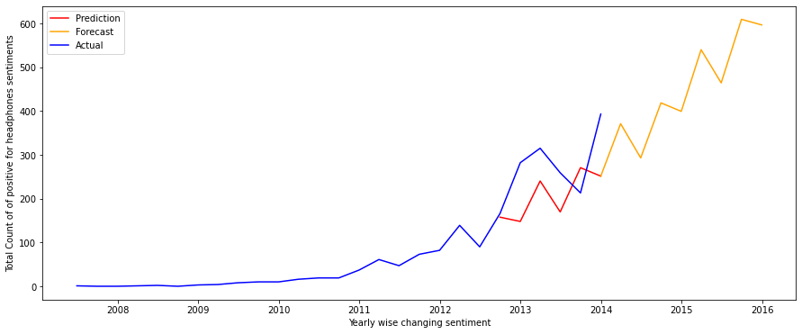
POSITIVE REVIEWS COUNT FOR A RANDOMLY SELECTED PRODUCT
PRODUCT ID : B000ULAP4U; PRODUCT NAME : HEADPHONES;
2016 JAN
580
2014 JAN
220

Slide 19
TOP RATED FROM DIGITAL MUSIC CATEGORY
PRODUCTS
BRANDS
Measure of a Man
Some Hearts
Come Away with Me
Meteora
The Eminem Show [Limited Edition w/ Bonus DVD]
Get Rich Or Die Tryin
Sbme/Arista
Emm/Blue Note
Eagles
Polydor
SCOTT,JILL
Sony
Red hot chili peppers
Selected on the basis of overall score count

Slide 20
FREQUENTLY BOUGHT TOGETHER FROM DIGITAL MUSIC CATEGORY
PRODUCTS
TAGS
BRANDS
Come Away with Me
Gotta Get Thru This
One Night Only
At Folsom Prison
Reflections: Carly Simon's Greatest Hits
Beaches: Original Soundtrack Recording
CDs & Vinyl
Pop
Rock
Alternative Rock
Dance & Electronic
Blues
Country
Emm/Blue Note
Umgd/Mercury
CASH,JOHNNY
Ultimate
JOHN,ELTON
Atlantic / Wea
Red hot chili peppers
Selected on the basis of frequently bought together count

Slide 21
TOP RATED FROM MUSICAL INSTRUMENTS CATEGORY
PRODUCTS
BRANDS
Audio-Technica ATH-M50 Professional Studio Monitor Headphones with Coiled Cable
Snark SN1 Guitar Tuner
Blue Microphones Yeti USB Microphone – Silver
M-Audio SP-2 Sustain Pedal with Piano Style Action for Keyboards
Audio-Technica
Syba
Blue Microphones
M-Audio
Hal Leonard
Snark
Planet Waves
Selected on the basis of overall score count

Slide 22
FREQUENTLY BOUGHT TOGETHER FROM MUSICAL INSTRUMENTS CATEGORY
PRODUCTS
TAGS
BRANDS
AudioQuest LP record clean brush
Shure SFG-2 Stylus Tracking Force Gauge
Shure M97xE High-Performance Magnetic Phono Cartridge
Solo Jazz Guitar
AUDIO TECHNICA ATN3600L Replacement Stylus for The AT3600L
Instrument Accessories
General Accessories
Dance & Electronic
Soundtracks
DJ Equipment
Sheet Music Folders
CDs & Vinyl
Hal Leonard
Shure
Audioquest
American Recorder Technologies
Audio Technica
Hot Licks
Selected on the basis of frequently bought together count

Slide 23
INFORMATION OBTAINED FROM REVIEW TEXT OF DIGITAL MUSIC & MUSICAL INSTRUMENTS CATEGORIES
ARTISTS
Brian Wilson
John Lennon
Michael Bolton
James Brown
George Martin
Phil Spector
Enya
Zeppelin
Chuck Berry
Mark Linett
Fred Durst
Andy Warhol
Bob Dylan
Nirvana Aerosmith
Beethoven
Elvis Presley
ETHNICITY
American
British
Irish
Arabic
Japanese
Spanish
Russian
French
INSTRUMENTALISTS
John Petrucci
Frank Gambale
Paul Gilbert
Eric Clapton
Scott Henderson
Jimmy Bruno
Joe Morello
Eddie Van Halen
SPECIAL EVENTS
The Musica Viva Fest
Christmas
Halloween
Thanksgiving
Fourth Of July
ORGANIZATIONS
BBC
Sony
Yamaha
Audio Technica
Shure

Slide 24
RELATING PRODUCTS & OBTAINED INFORMATION FROM REVIEW TEXT
PRODUCT ID | PRODUCT NAME | SENTIMENTS | CATEGORY | RELATED INFO
0767851013 | Little Women (Collector's Series) | positive | Musical Instruments | Civil War
B0000001IQ | French Blues | positive | Digital Music | world war ii
B00000051V | Hi-Five: Greatest Hits | conflict | Digital Music | Michael Jackson
B0000004X3 | Grits Sandwiches for Breakfast | positive | Musical Instruments | Christmas
B000001A5T | Music for 2 Pianos &amp; Piano 4 Hands | positive | Musical Instruments | The French academy
B0000016PT | Nightingale: Japanese Art Songs | neutral | Digital Music | Japanese
B000000J8S | Johnnie Temple 1940- 1949 Vol. 3 | positive | Digital Music | Chicago

Slide 25
DIGITAL MUSIC CATEGORY BRANDS
Brands which received positive reviews on the basis of their sentiment score.
Brands which received negative reviews on the basis of their sentiment score.
Rebel Records
Trans Siberian Orchestra
Black Wolf Records
Celly Cell
Sony
Elecktra
Warner Brothers
Reprise
EMI
Maverik
ULG
MCA
Manifesto
Rykodisc

Slide 26
MUSICAL INSTRUMENT CATEGORY BRANDS
Brands which received positive reviews on the basis of their sentiment score.
Brands which received negative reviews on the basis of their sentiment score.
PDP
OP/Tech USA
The Wholesale House
Schylling
Engelhradt
Yamaha
Fender
JSI
FlightForm
Ruby
Rapco Horizon
Barrington
CAIG Laboratories
Direct Sound

Slide 27
CONCLUSION
Using text classification, we can predict sentiments for future reviews & help to build an interactive chatbot for the website which helps to understand the customer’s feedback in real time.
Companies can gain intel about their products & competitors to understand what their customers think and feel about their brand and reduce customer churn.
Top rated & Frequently bought together products & brands can be recommended to the customers who are shopping in that related category.
Other miscellaneous information such as popular music artists, ethnicity, locations, special dates can be extracted from review texts and can be associated with product recommendation.

Slide 28
THANK YOU

